Slide 1
Douglas library of hebron
STRATEGIC PLAN 2018-2022

Slide 2
PLANNING COMMITTEE MEMBERS
MEMBER | Organization Affiliation
ALTHEA CARR | Douglas Library of Hebron; Board of Trustees, Vice Chairperson
F. PETER CASARELLA | Douglas Library of Hebron; Board of Trustees, Secretary
DONNA LANZA | Douglas Library of Hebron; Town Liaison to the Board of Trustees
GAIL B RICHMOND | Board of Selectmen Douglas Library of Hebron; Board of Trustees
BRENDA KELEHER | Friends of the Douglas Library
ELIZABETH SCHMEIZL | Community Representative
LAUREN FIERMAN | Moderator
CLARE BETZ | Staff, Head of Circulation
AMANDA BROUWER | Staff, Library Director
DEBORAH HART | Staff, Retired
CHERYL LABOMBARD | Staff, Head of Children’s Department

Slide 3
The Committee

Slide 4
Mission Statement
The Mission of the Douglas Library of Hebron is to service the informational, educational, cultural and recreational needs of all members of the Hebron community by providing access to a professional staff, state of the art facility, quality resources, programs and support and preserve records of the town’s history that are entrusted to the library.

Slide 5
Why we are planning
Last Strategic Plan was from 1992
Evaluate existing services
Plan our direction for the future
Allow for input from community, staff and Library Board
Create a measurable path for progress

Slide 6
VISION STATEMENT
The Douglas Library of Hebron is an integral part of our community offering a welcoming, safe and diverse environment in which to pursue lifelong learning by utilizing our ever-evolving collections, services and innovative technologies.

Slide 7
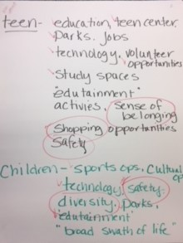
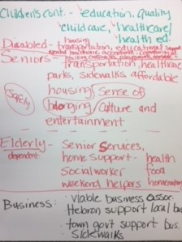
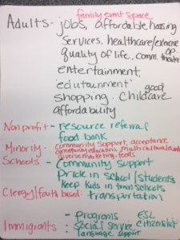

Slide 8
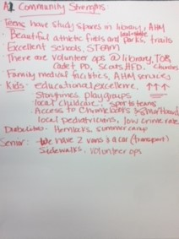
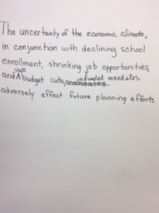
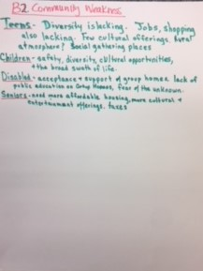
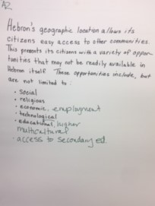

Slide 9
OUR fUTURE
SAFE SPACE· TECHNOLOGY· DIVERSITY·
COMMUNITY· LIFELONG LEARNING

Slide 10
GOALS AND TASKS
Safe Space
A safe and welcoming library
-Maintain a collaborative relationship with emergency services
-reduce reportable incidences
-maintain physical plant

Slide 11
GOALS AND TASKS
Technology
Access to the most sophisticated technology available
-Develop a tech plan in conjunction with the Town's
-In house software/hardware research committee
-Staff training in technology

Slide 12
GOALS AND TASKS
Diversity
A positive environment where diversity is welcomed and celebrated
-A dedicated Teen Area
-Increase public awareness of services for all demographics
-Make current space more welcoming

Slide 13
GOALS AND TASKS
Community
A community resource for civic and cultural activities
-Create a staff committee on community outreach initiatives
-Increase usage of space by a broad range of community groups
-Review current Meeting Room policies with Board of Trustees

Slide 14
GOALS AND TASKS
Lifelong Learning
With inspiration for lifelong learning through programming, collections and social interactions
-Provide materials that meet the needs of everyone
-Increase door count
-Provide practical life skills seminars and workshops

Slide 15
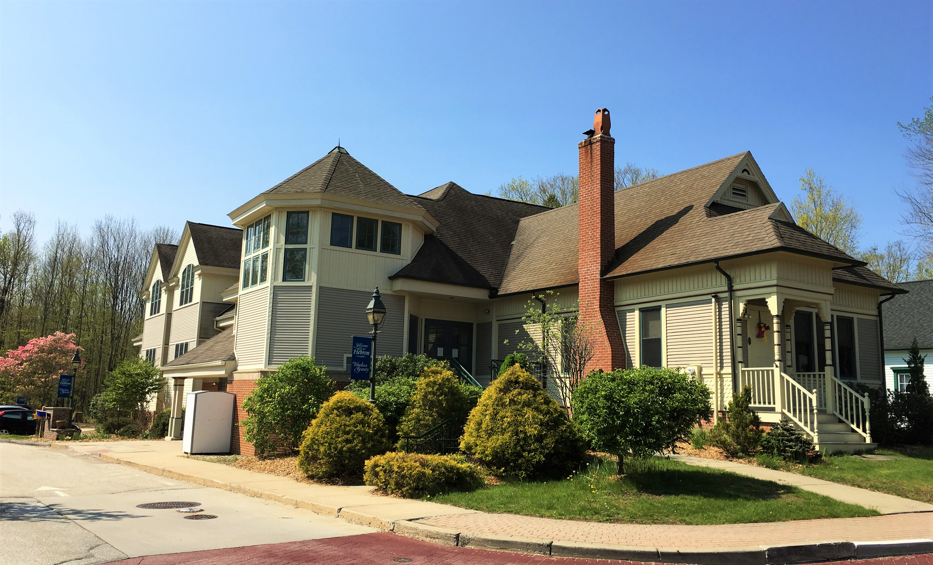

Slide 16
Questions, comments or suggestions?

Slide 17
Contact Us
Email us: info@douglaslibrary.org
860.228.9312
Feedback on this plan welcomed until November 12th, 2017

Slide 18
Thank you!

